Slide 1

Introduction to AI (AI101B) EVEN Semester Session 2024-25
Handwritten Digit Recognition
Aman Kumar 202410116100020
Alok Kumar 202410116100018
Anand Patel 202410116100023
Ambikeshwar Dutt Dwivedi 202410116100022

Slide 2

Handwritten Digit Recognition
A deep learning model trained on the MNIST dataset, coupled with a user-friendly GUI, for recognizing handwritten digits.

Slide 3
Introduction
Handwritten Digit Recognition
Project Objective
A task where machines learn to interpret handwritten numbers, enabling applications like postal automation and form processing.
To develop an accurate handwritten digit classifier using deep learning and build a user-friendly GUI for user interaction.

Slide 4
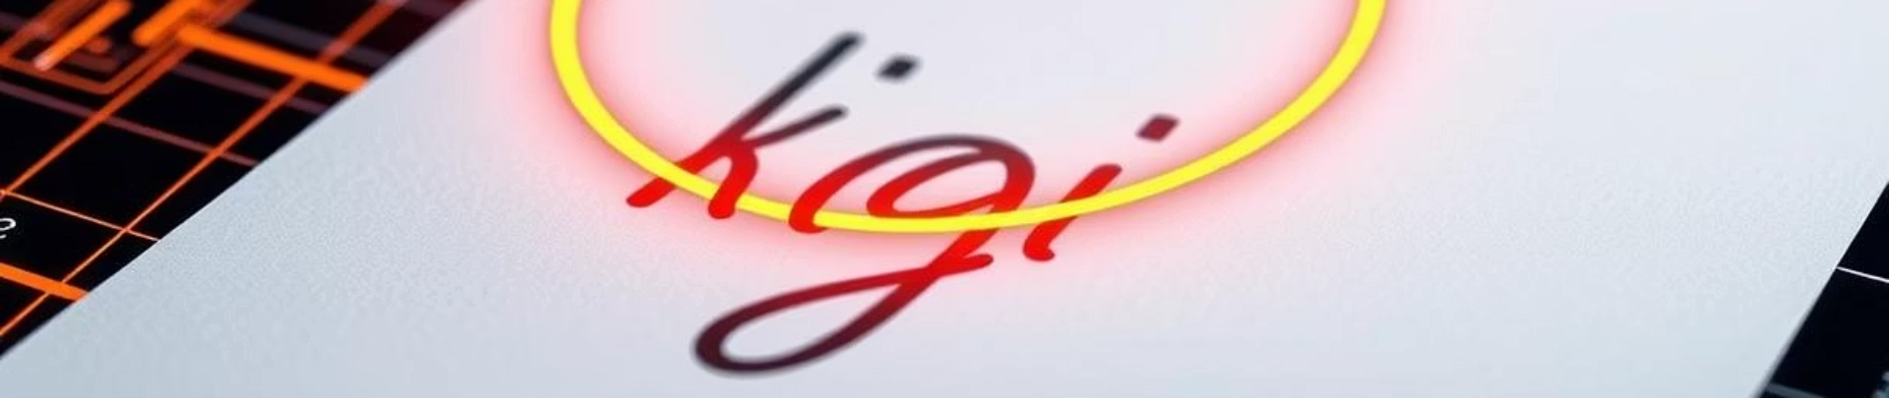
Dataset - MNIST
MNIST Dataset
Image Properties
Advantages
A widely used benchmark dataset containing tens of thousands of handwritten digit images.
Each image is 28x28 pixels in grayscale, representing digits from 0 to 9.
Its clean and well-labeled nature makes MNIST ideal for image classification research.

Slide 5




Model Architecture
Flatten Layer
1
Converts image into a linear vector of features.
Dense Layer 1
2
Performs non-linear transformations using ReLU activation.
Dense Layer 2
3
Further transforms features with ReLU activation.
Output Layer
4
Predicts probability for each digit using Softmax.

Slide 6
Training and Evaluation
Preprocessing
Training Parameters
Results
Normalization of pixel values and label conversion to one-hot vectors.
Model trained with specified epochs, batch size, and validation split.
The model achieves high test accuracy, indicating good performance on unseen digits.

Slide 7
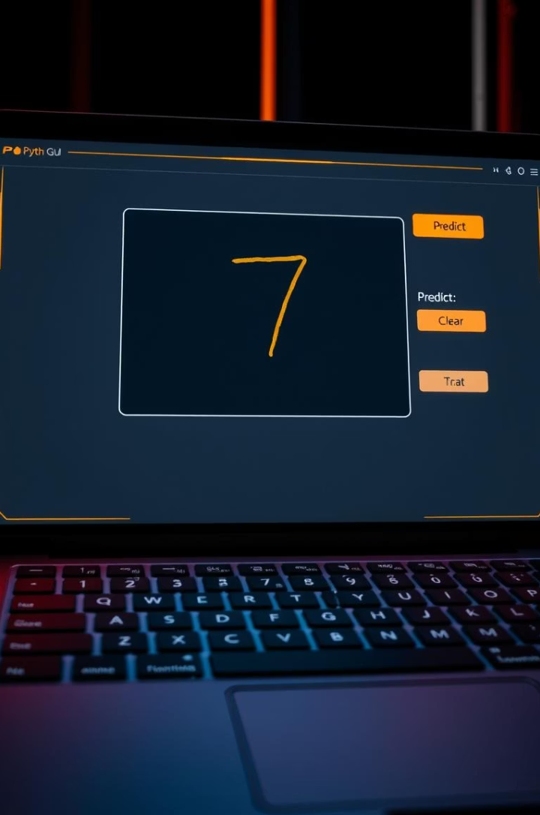




GUI Using Tkinter
Canvas
Predict Button
Clear Button
Provides a space for users to draw handwritten digits.
Triggers the model to process the drawn digit.
Resets the canvas for drawing a new digit.
Label
Displays the predicted digit output from the model.

Slide 8
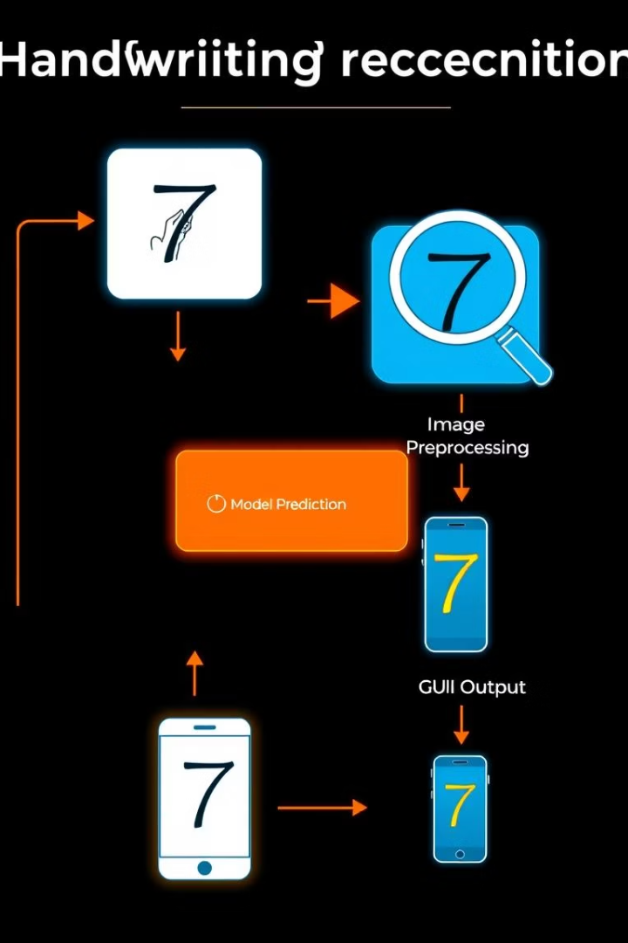
Process Flow
1
User Draws Digit
User interacts with the GUI to draw a digit on the canvas.
2
Image Preprocessing
The image is resized, inverted, and normalized for model input.
3
Model Predicts
The processed image is fed to the trained model for prediction.
4
GUI Displays Result
The predicted digit is displayed in the GUI for the user to view.

Slide 9
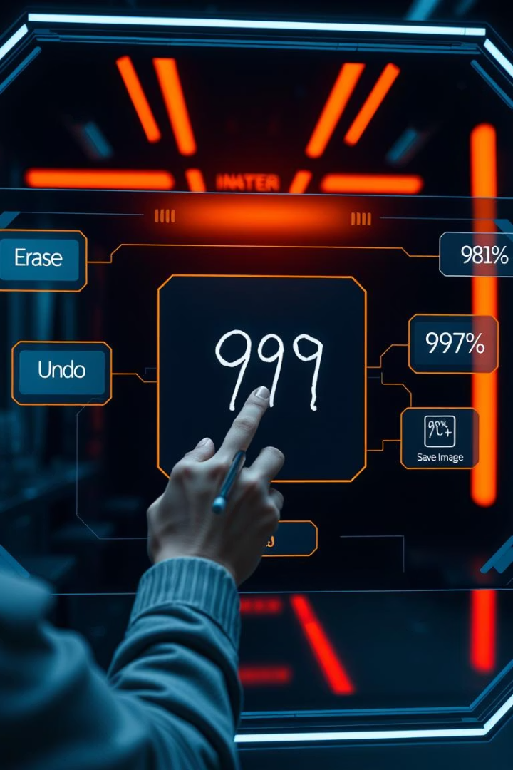
Future Improvements
CNNs
GUI Enhancements
Transitioning to a Convolutional Neural Network for potential higher accuracy.
Adding features like an erasing tool, undo button, and confidence score display.
Deployment
Exploring the potential of deploying the project as a web or mobile application.

Slide 10
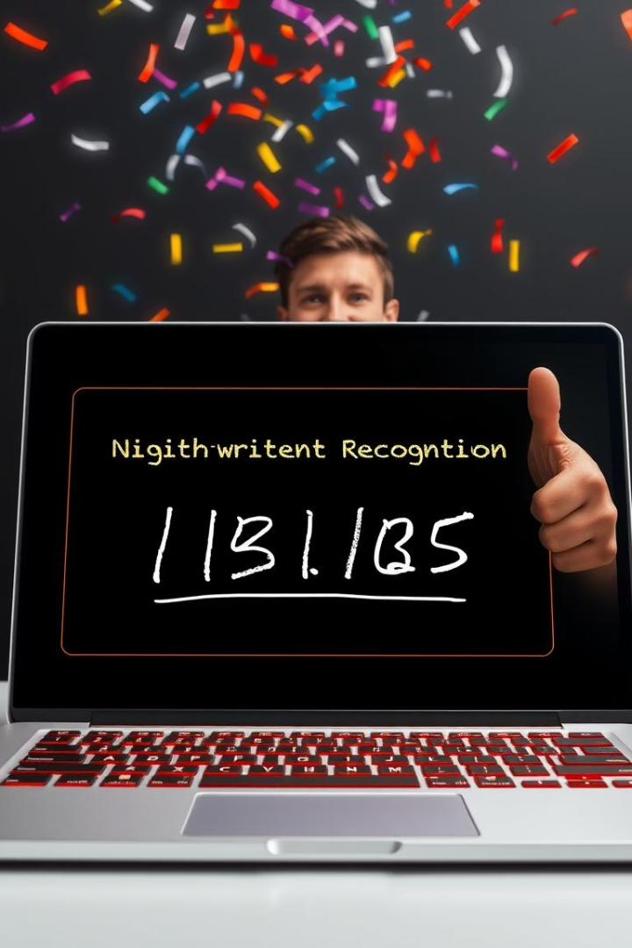
Conclusion
This project demonstrates the power of deep learning in recognizing handwritten digits and the feasibility of creating user-friendly AI applications.

